Slide 1
Final Project
Stewart Merritt

Slide 2
Introduction
Overview
The primary goal of this analysis was to explore various NBA player and team statistics to understand performance trends.
The analysis aims to provide valuable insights to teams, coaches, players, and sports analysts

Slide 3
Methodology
https://www.kaggle.com/datasets/orkunaktas/nba-players-stats-2324
CSV file from Kaggle.com which had all stats for every player in the NBA
I completed the project in Python using Jupyter Notebook.
I used the Pandas Library and Matplotlib to complete the project

Slide 4
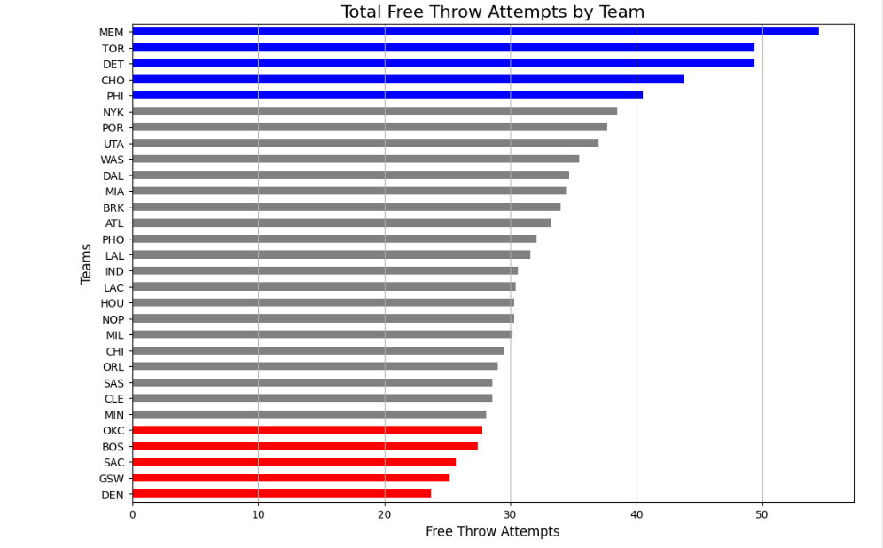
Insights
Free throw attempts per game
We observed how teams differ in their free throw attempts, indicating team strategy and offensive style.

Slide 5
Future Work
New Questions
How does an individual's performance affect the team's ability to win?
More information like injury history and how an injury might affect certain players career trajectory

Slide 6
Questions

